Slide 1
Meeting with Eva and Anthony + notes for Andy
15/02/24
Andy – please feel free to ignore hidden slides (e.g. project background)

Slide 2
Searching for a Sulfotyrosine (_{s}Y) in a ha_{p}Ystack
Sulfation can easily be misidentified as Phosphorylation
Sulfation vs Phosphorylation – tiny mass difference 0.009516 Da
In tandem mass spec, a precursor ion (e.g the entire ionised peptide) is subjected to fragmentation. During this process, the sulfo headgroup is lost => difficult to provide positive evidence of sulfation.
Most samples are enriched for phosphopeptides (artefact of sample prep – e.g. ion affinity chromatography).
Further adding to the problem, sulfation is much rarer than phosphorylation.

Slide 3
Sulfotyrosine (sY) Identification – is it possible (via MS)?
Sulfation can easily be misidentified as Phosphorylation
Sulfation vs Phosphorylation – tiny mass difference 0.009516 Da
A typical mass spec instrument would struggle to detect this difference.
Most instruments have a mass accuracy of ~10 ppm:
e.g. in a typical peptide (2000-4000 Da), this is 0.02-0.04 Da mass accuracy.
Cutting edge instruments achieve ~2 ppm accuracy
(0.004 – 0.008 Da for a typical peptide).

Slide 4

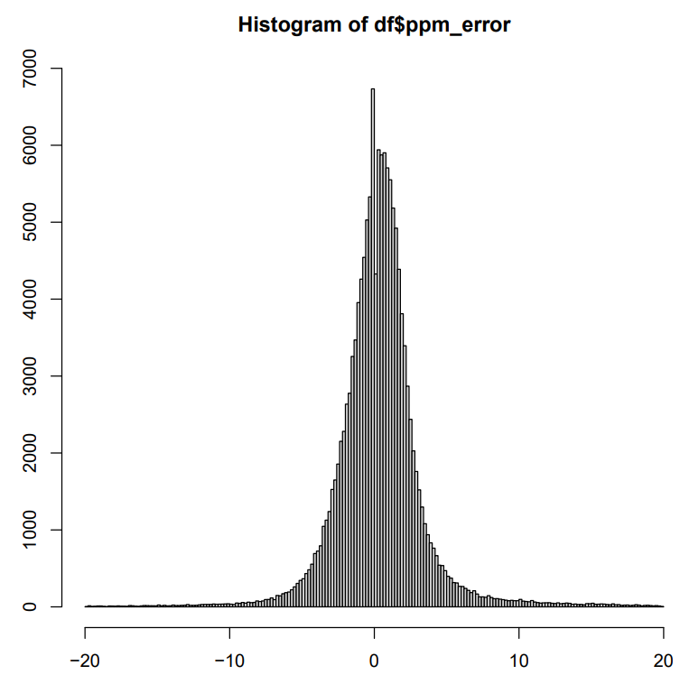
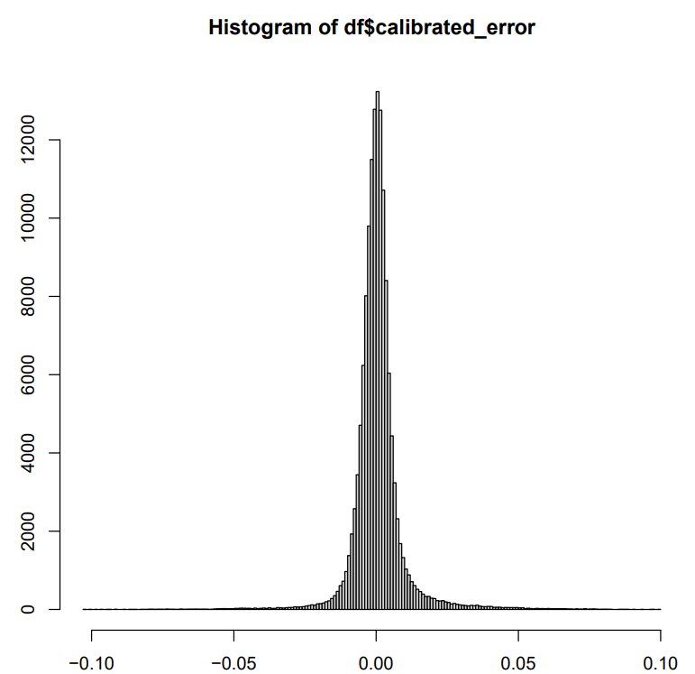
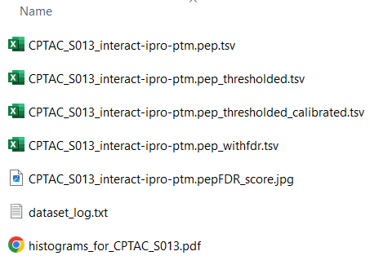
Workflow Stage 1: Aggregate data by peptidoform ID
HUMAN PHOSPHOPROTEOME
129 proteomic mass spec datasets
Data
Processing
> 2,300,000 peptides with PTMs
Most peptides should have sufficient mass accuracy even in older instruments with ~ 10 ppm error
1) Extract data
2) Convert to .tsv,
3) Calculate FDR
4) Threshold: FDR < 0.01
5) Recalibrate

Slide 5
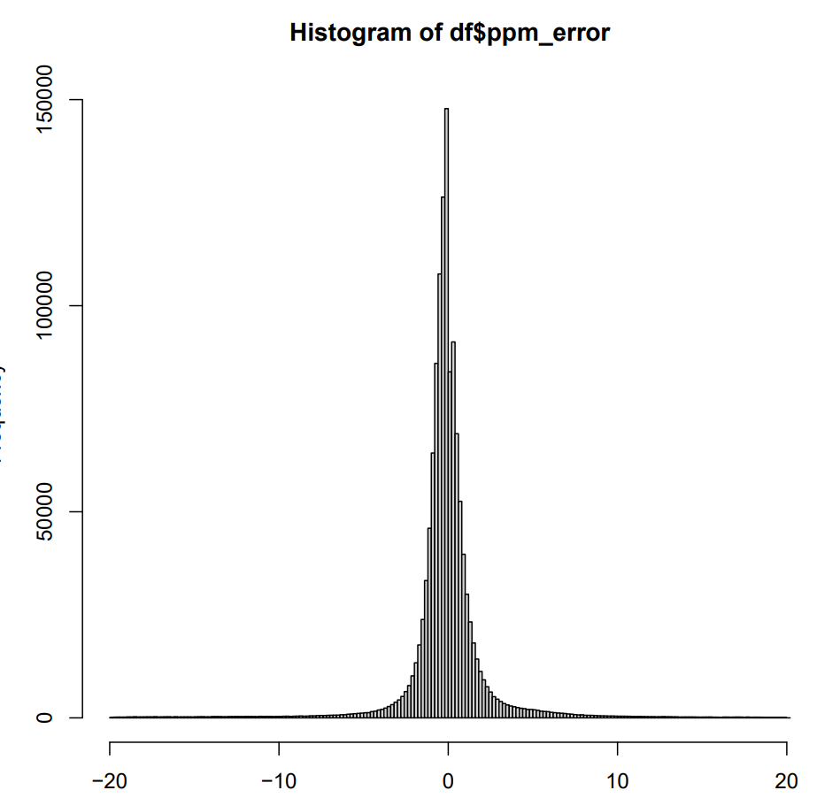
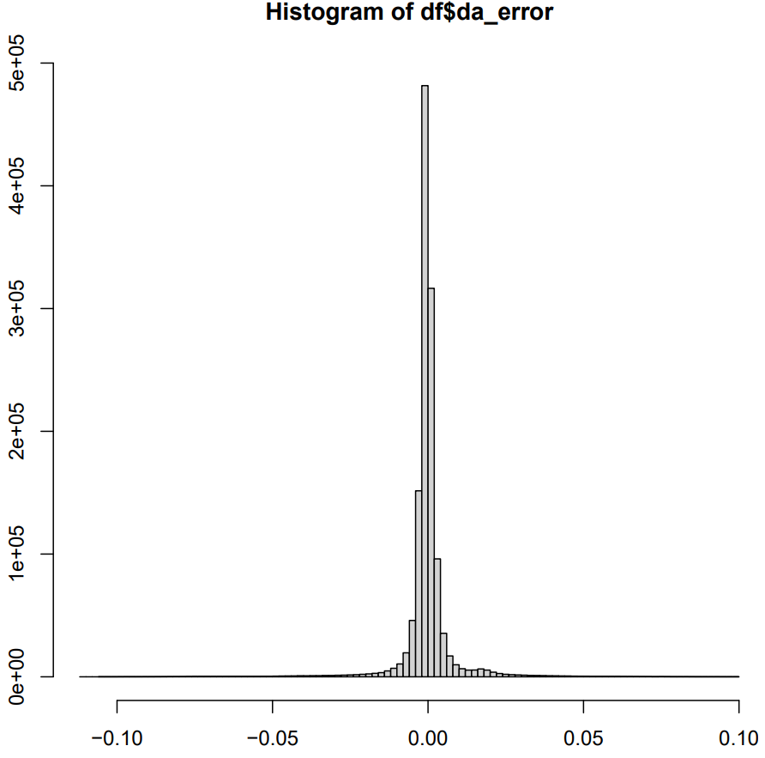
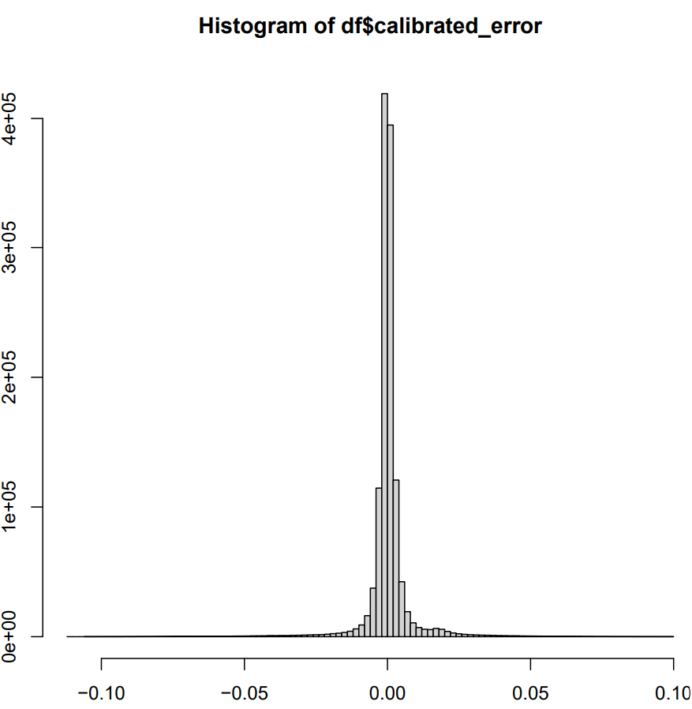
Example histograms
CPTAC_S061-s061_pancrea-pdac_phospho-imac_tmt

Slide 6
Workflow Stage 1: Aggregate data by peptidoform ID
HUMAN PHOSPHOPROTEOME
129 proteomic mass spec datasets
Data
Processing
> 2,300,000 peptides with PTMs
Peptidoform
Aggregation
1,747,947
peptidoform IDs
1) Extract data
2) Convert to .tsv,
3) Calculate FDR
4) Threshold: FDR < 0.01
5) Recalibrate
1) peptides containing
phosphorylated S, T, or Y
2) Generate non-strict peptidoform IDs and aggregate the data
Detected in multiple datasets?
Detected in sufficient amount of spectra?
Does it have the expected mass shift?
Peptide amino acid sequence
PTM1_count
PTM3_count
nEQSPPPPLQTSSGAEVMDVGSGGDGQSELPAEDPFNFYGASLLSK_M147_1_n230_1_S167_1
non-strict = PTM position does not matter - any S can be pS
PTM2_count
nEQSPPPPLQTSSGAEVMDVGSGGDGQSELPAEDPFNFYGASLLSK_n230_1_S167_1
The same peptide can have multiple peptidoforms based on PTMs present

Slide 7
Workflow Stage 2: GMM AUC Filtering
443 peptidoform IDs assigned to expected m/z bin for sY
1,747,947
peptidoform IDs
Pre-GMM
Filtering
83,047
peptidoform IDs
GMM
Selection
One GMM per peptidoform ID
GMM AUC
Filtering
1) Detected in 3+ experiments:
413,010 IDs
2) Overall more than 90 PSMs
1) Fit Gaussian Mixture Models (GMMs) with 1, 2, or 3 components for the calibrated mass errors of each peptidoform ID
2) Prioritise fewer components unless BIC score of model with more components is 10+ points smaller (rule of thumb)
Does a sufficient proportion of the calibrated masses fall around the expected m/z shift of -0.0095 Da?
Define m/z bins
Compute area under the curve (AUC) that falls within that bin based on best GMM model’s probability density function(s) (PDFs)
Assign peptidoform ID data into a bin range if >15% summed AUC for all components falls over that bin (10 bins total)
Does a large enough fraction of PSMs have the expected mass shift for each of these peptidoforms?

Slide 8
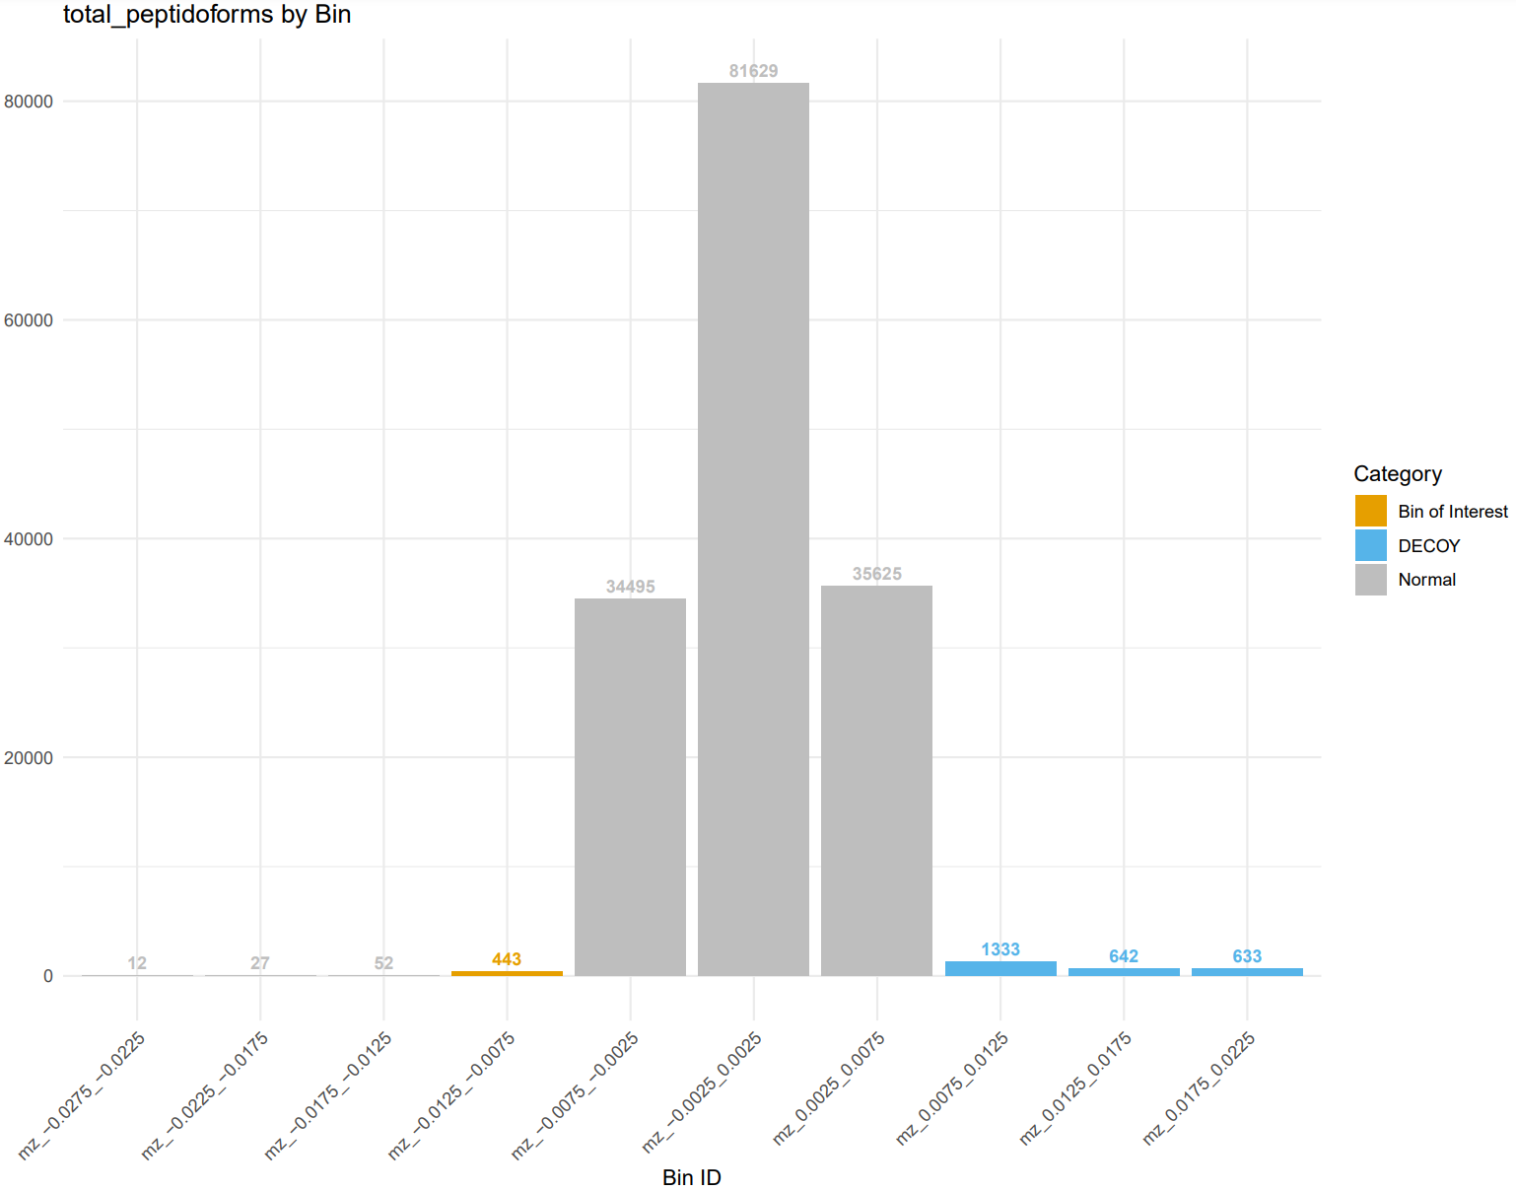
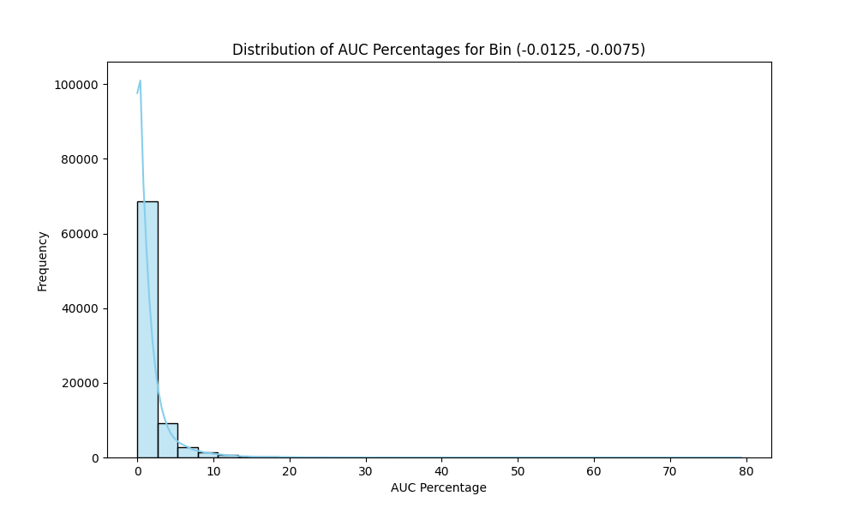
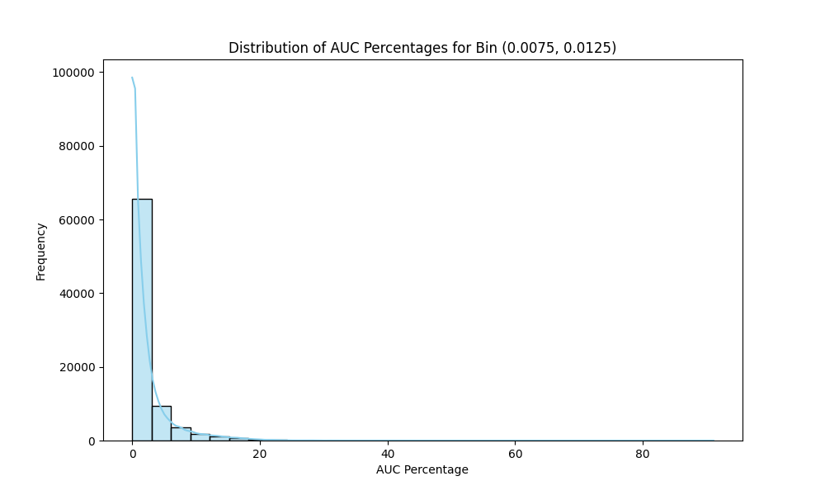
Total number of peptidoform IDs by bin

Slide 9
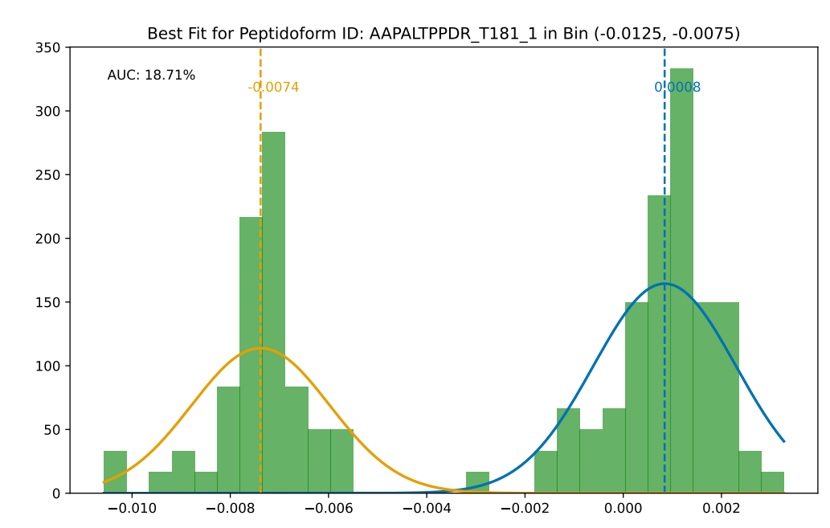
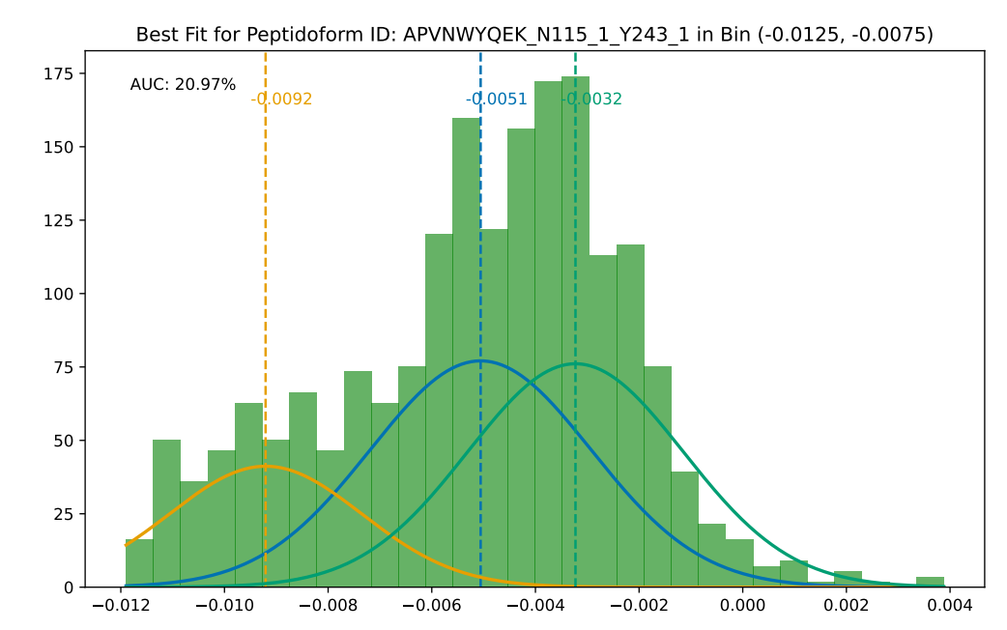
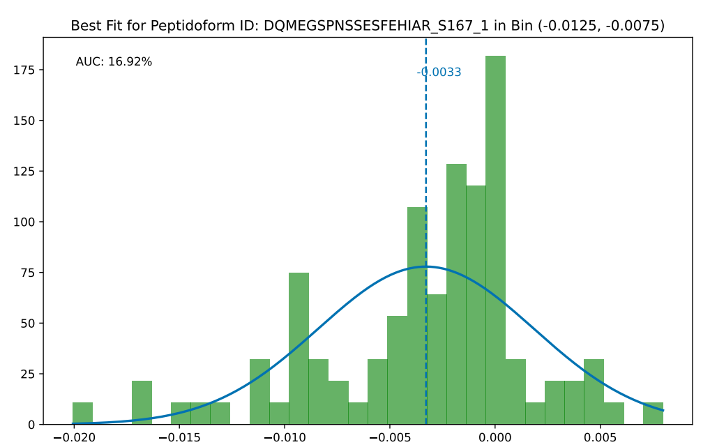
Histograms
https://www.dropbox.com/scl/fo/l160uy3a1ugu7hfahhrer/h?rlkey=tfgsgi1neg6osbqs48uaayqts&dl=0
with this filtering it seems we get fewer false positives? (just by eyeballing, e.g bin of interest)
Histograms one bin to the left – seem even more convincing (i.e. fewer false pos hits + 5 unique IDs that are potentially doubly sulfated and fall at m/z -0.02)
Genomics Dropbox\Jordan Tzvetkov\0_Projects\Sulfotyrosine Project\backup_2024_02_15\02_Peptidoform_GMM_AUC_filtering\output\histograms

Slide 10
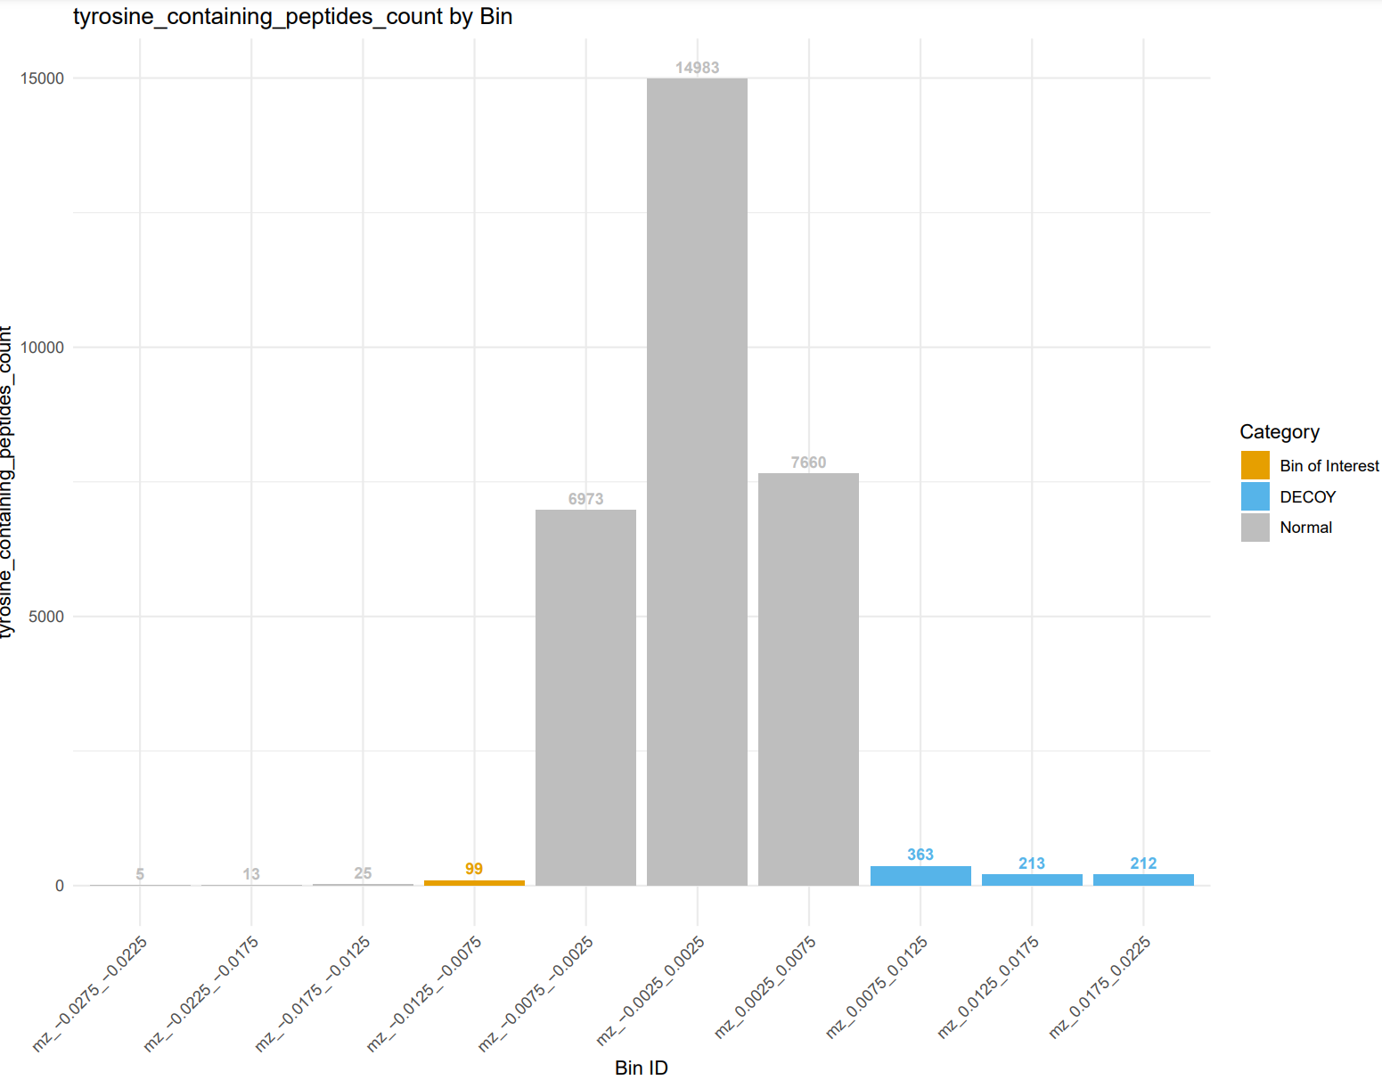
tYrosine-containing peptidoform IDs by bin
We have reduced the number of peptidoforms tremendously!
From 1,747,947 in total to ~ 99 that could contain a sY

Slide 11
Workflow Stage 3: post-GMM analyses
Chi-squared
Functional enrichment
Manual protein ID inspection and annotation
Motif enrichment (not yet, perhaps too few IDs)

Slide 12
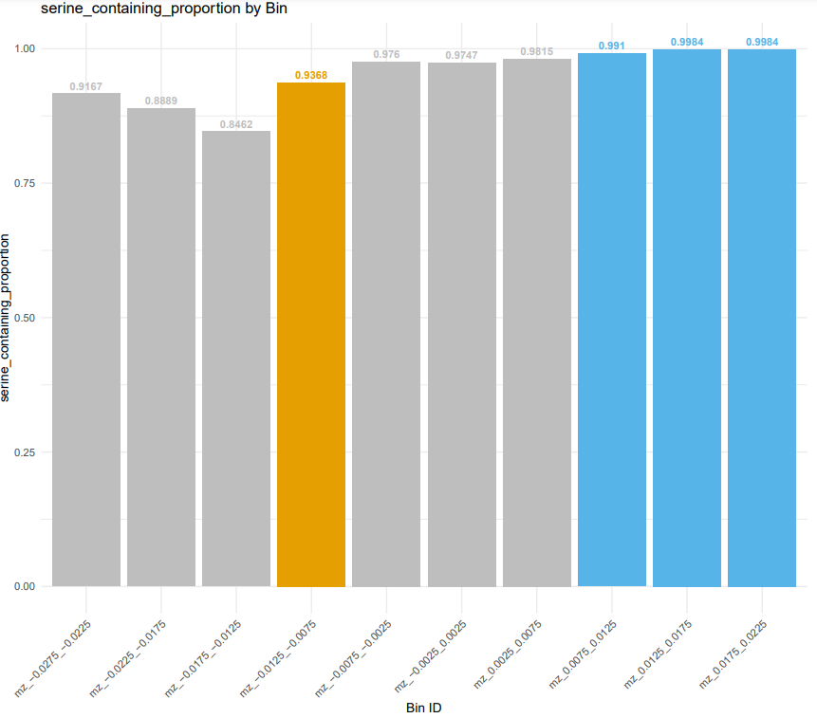
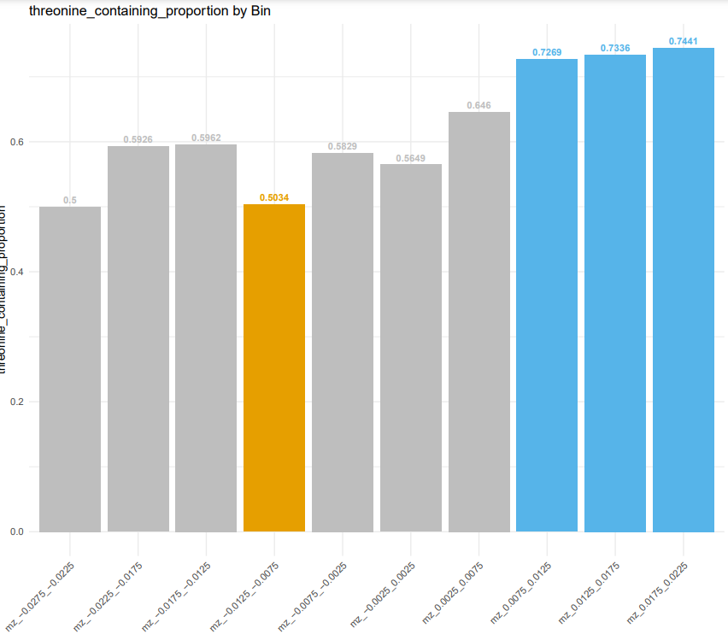
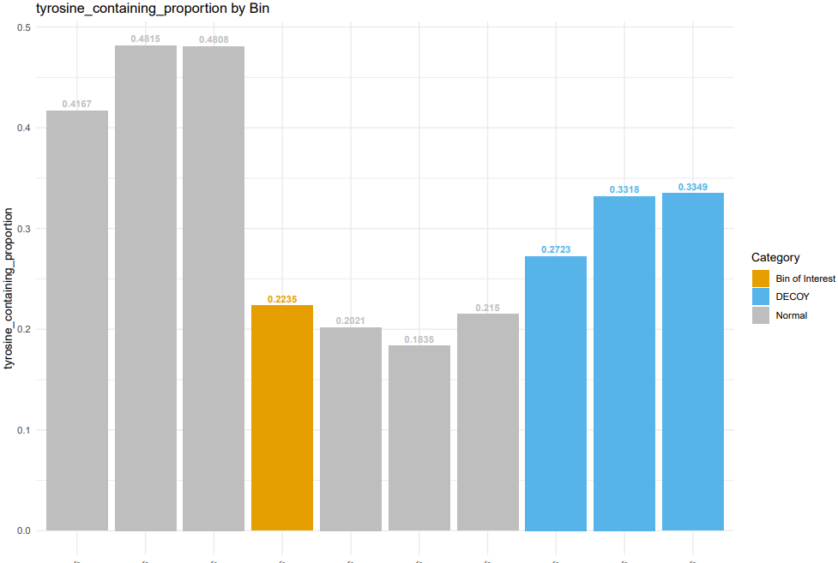
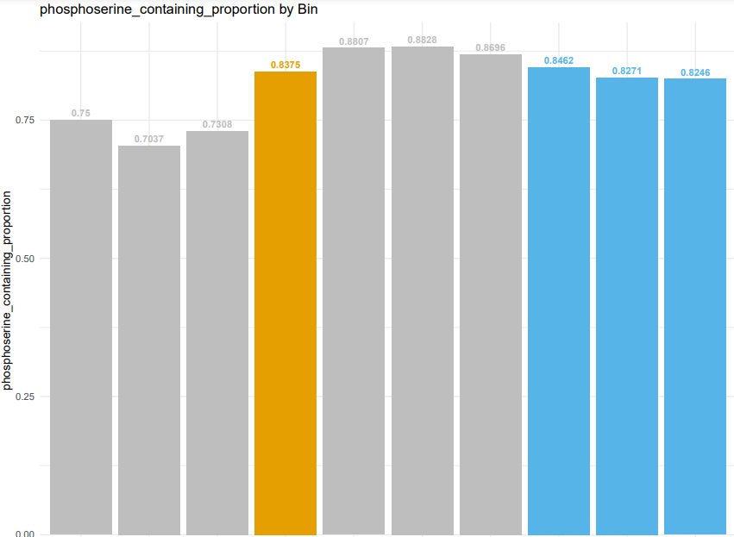
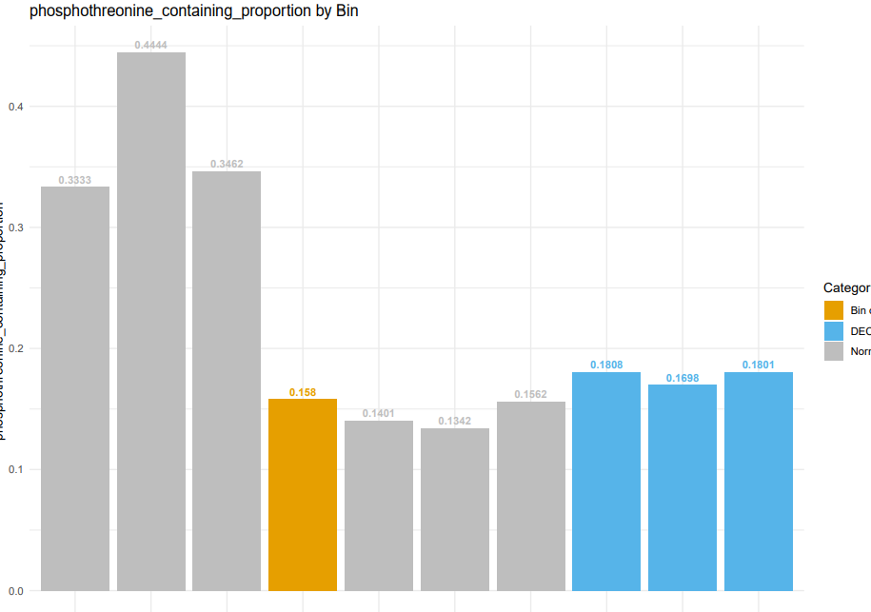
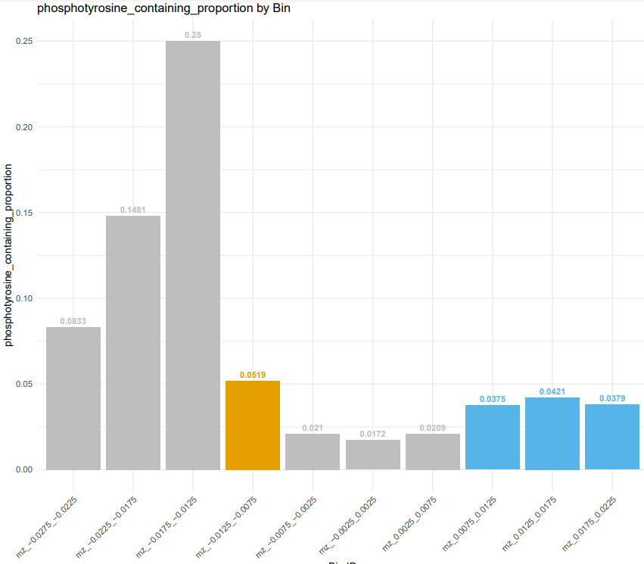
Bar plots of distribution of IDs by bin
S
T
Y
pS
pT
pY
NB: proportions of very small total numbers! (<100)

Slide 13
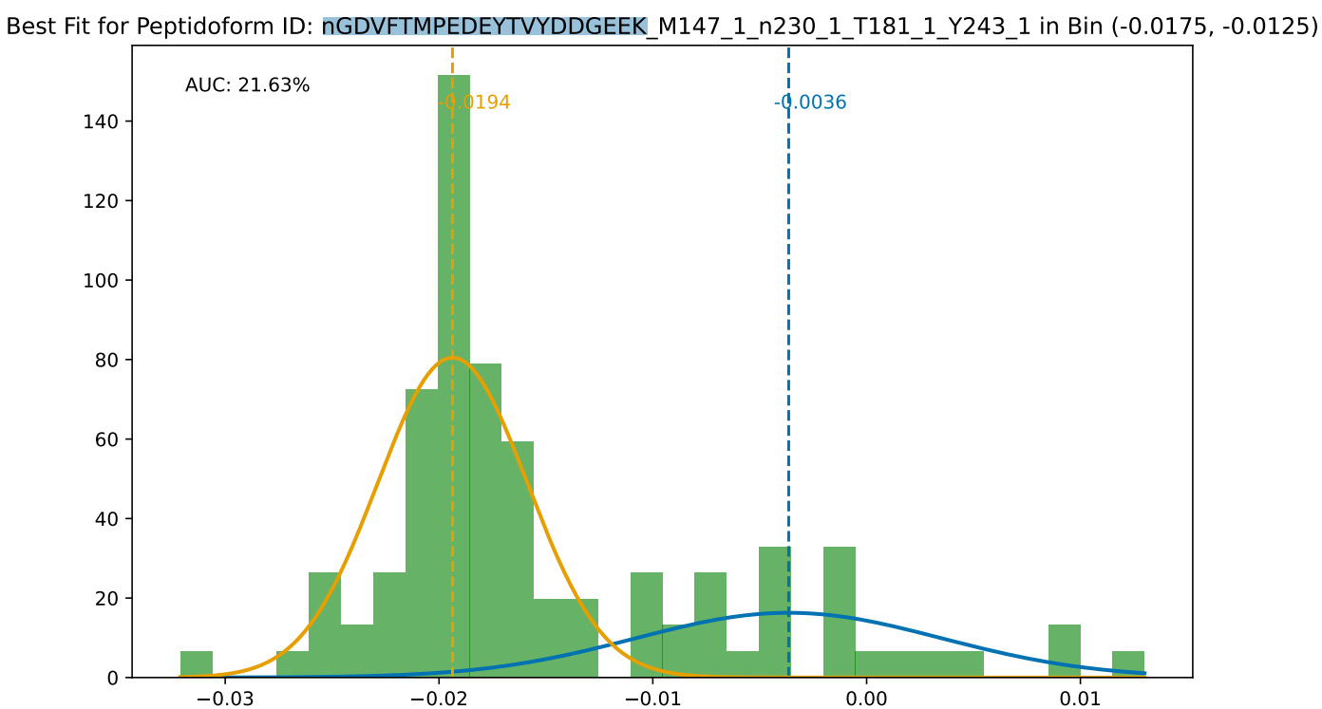
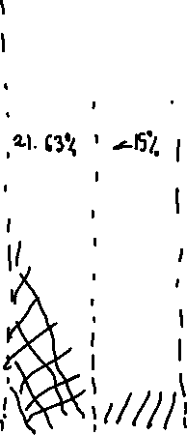
m/z -0.0175_-0.0125 – 5 unique IDs
Doubly sulfated?

Slide 14
Chi-squared residuals
– show pdfs
done on counts
+ a bit ‘hacky’ on proportions
I may have done it wrong? Chat with Anthony later?

Slide 15
Pathway enrichment analysis hypothesis
Sulfated proteins are often secreted or transmembrane;
Evidence for sulfation in Golgi. Therefore,
We will enrich in membrane-bound or secreted proteins in the bin of interest, but not in the DECOY bins.
The respective GO terms and KEGG pathways should reflect that, although due to the small number of IDs in these bins, the power of the analysis may be low.

Slide 16
Pathway enrichment - filtering
Tyrosine-containing phosphorylated peptidoforms
(not pY): some PTMs might be mis-assigned to incorrect amino acid and we’ve not done FDR thresholding on this (don’t fully understand assignment but it’s based on PTM prophet; Andy advised to go with Y-containing )
Foreground:
Y-containing in
Bin of interest
DECOY Foreground:
Y-containing in
DECOY Bin(s)
Background:
Y-containing in
all bins
Only include peptidoforms with assigned protein IDs that are part of SwissProt (reviewed human proteome, ~20,000 proteins)

Slide 17
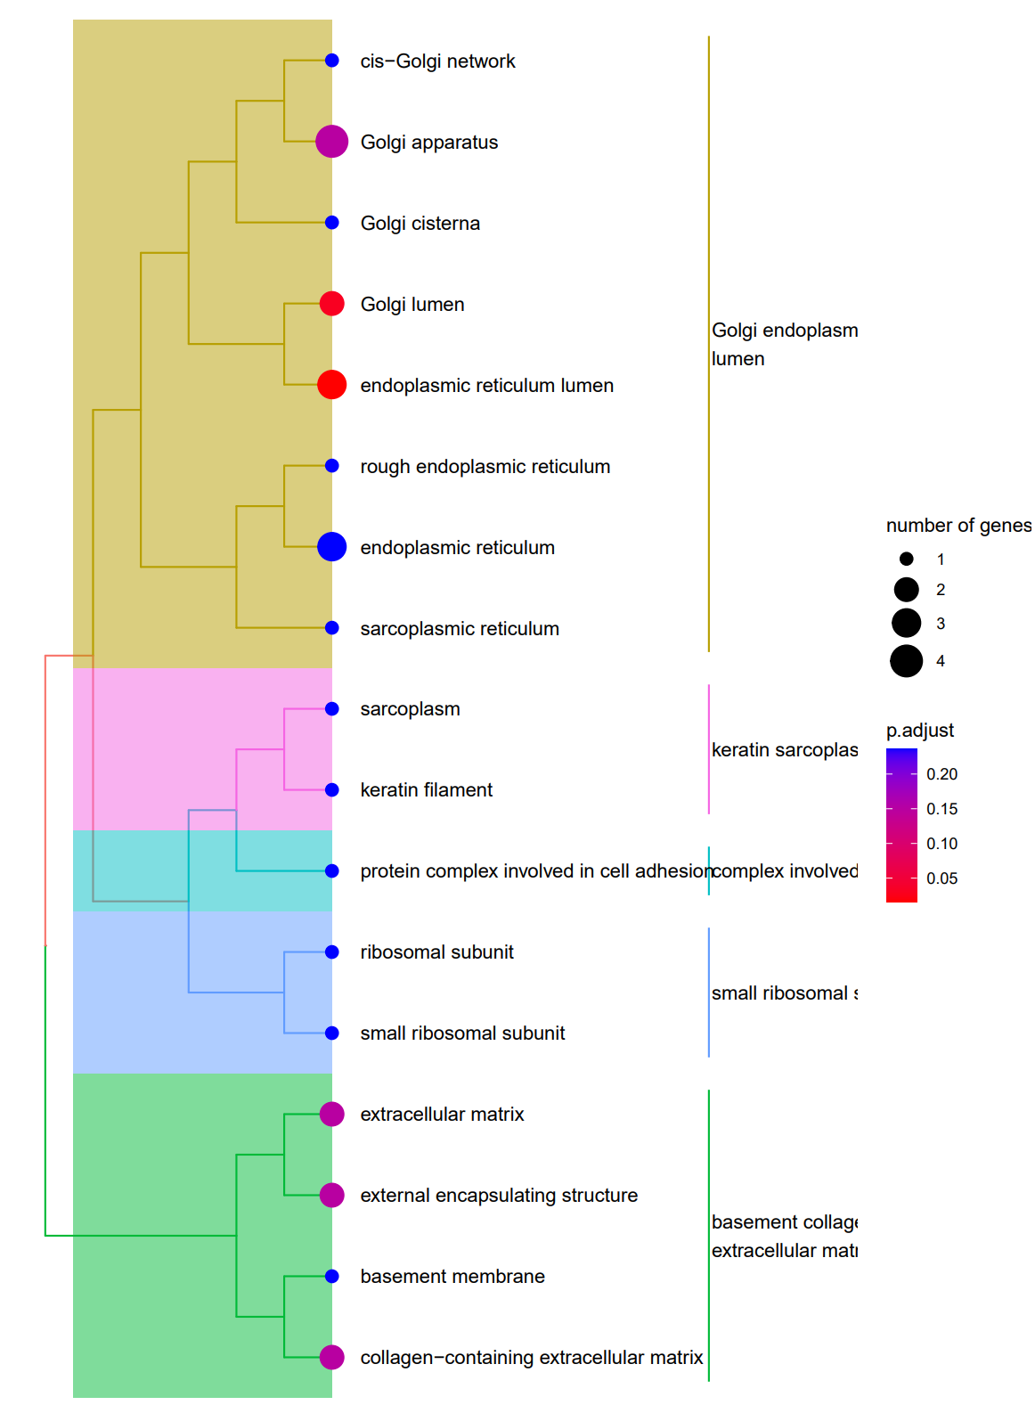
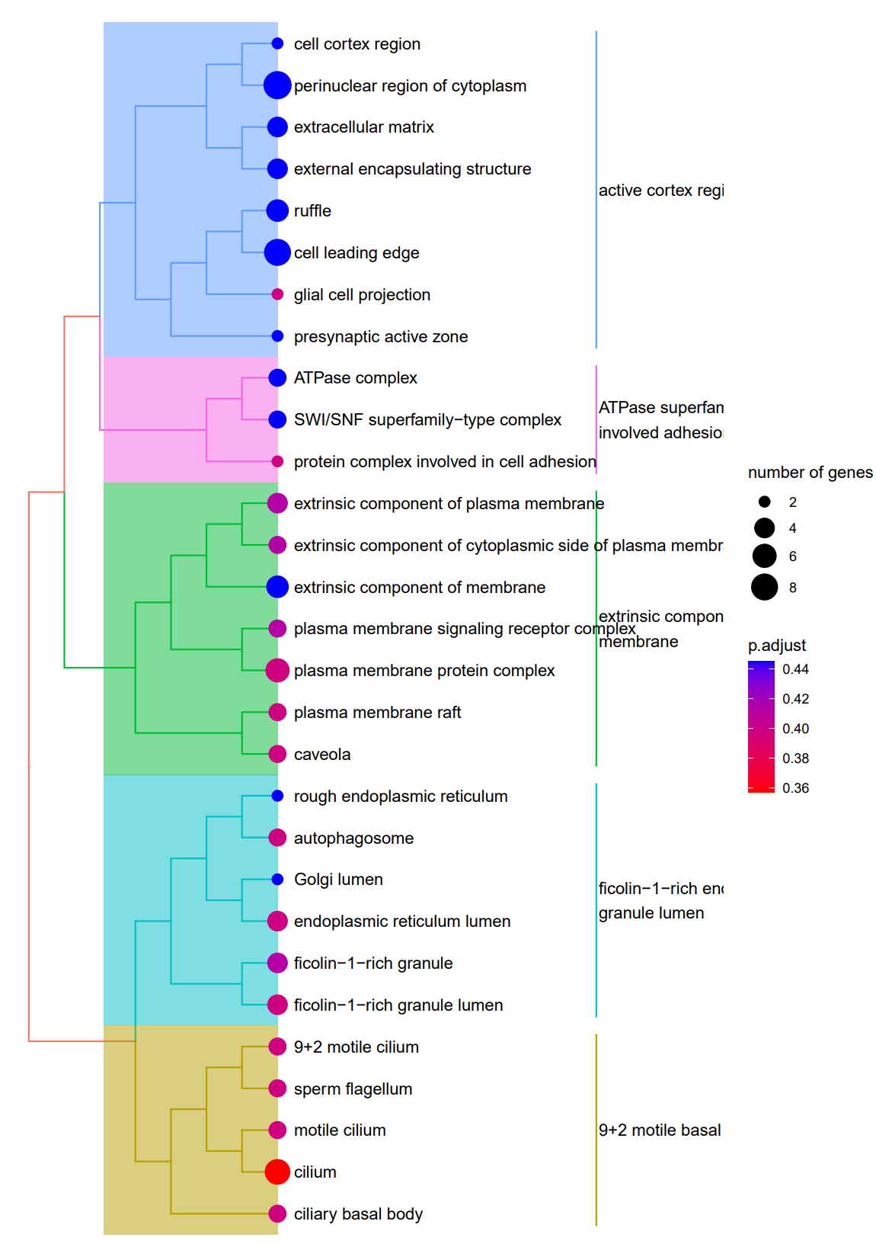
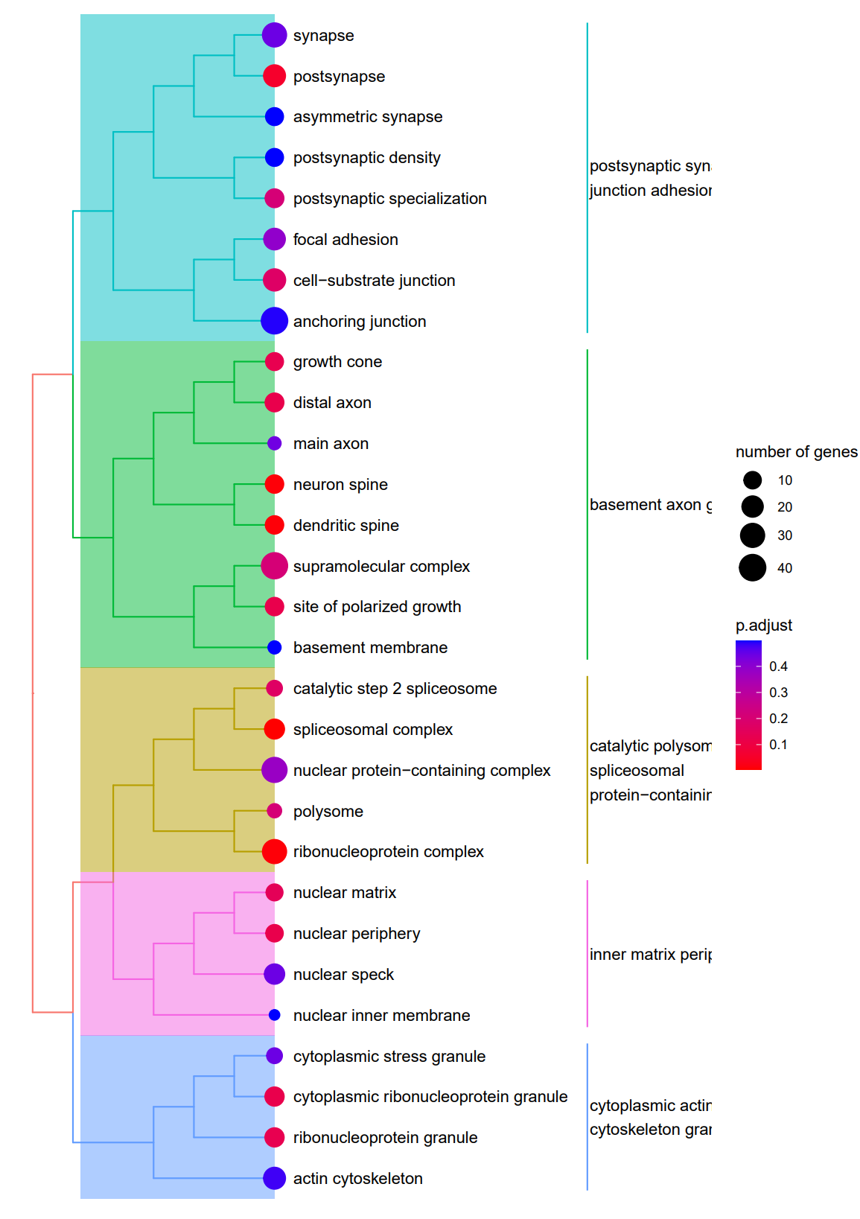
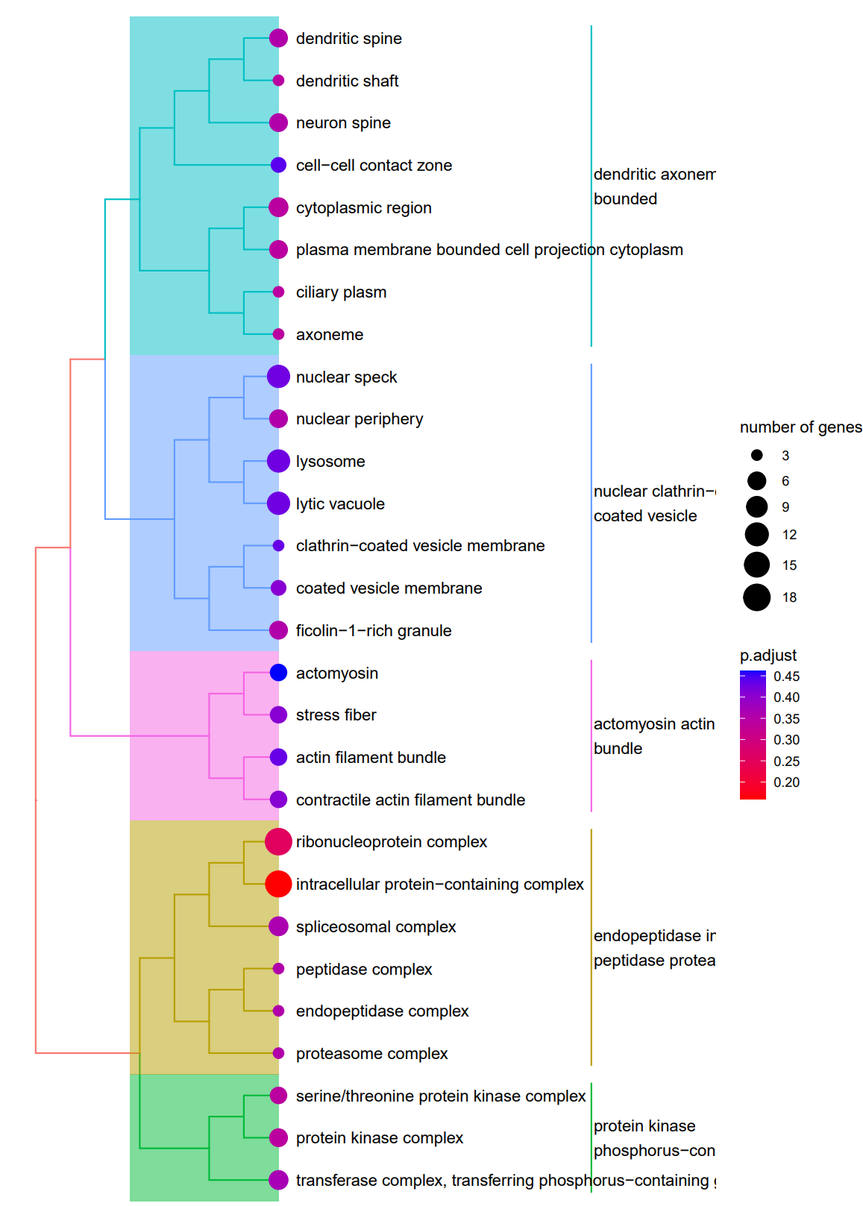
Enrichment analysis: Cellular Component GO terms
NB: Small number of genes, hits not significant post-FDR, but seem biologically relevant
m/z -0.0175_-0.0125
m/z -0.0125_-0.0075
m/z 0.0075_0.0125
m/z 0.0125_0.0175
Golgi-related
ECM
+ membrane components
ECM
= secreted
No secreted, membrane, or Golgi
No secreted, membrane, or Golgi

Slide 18
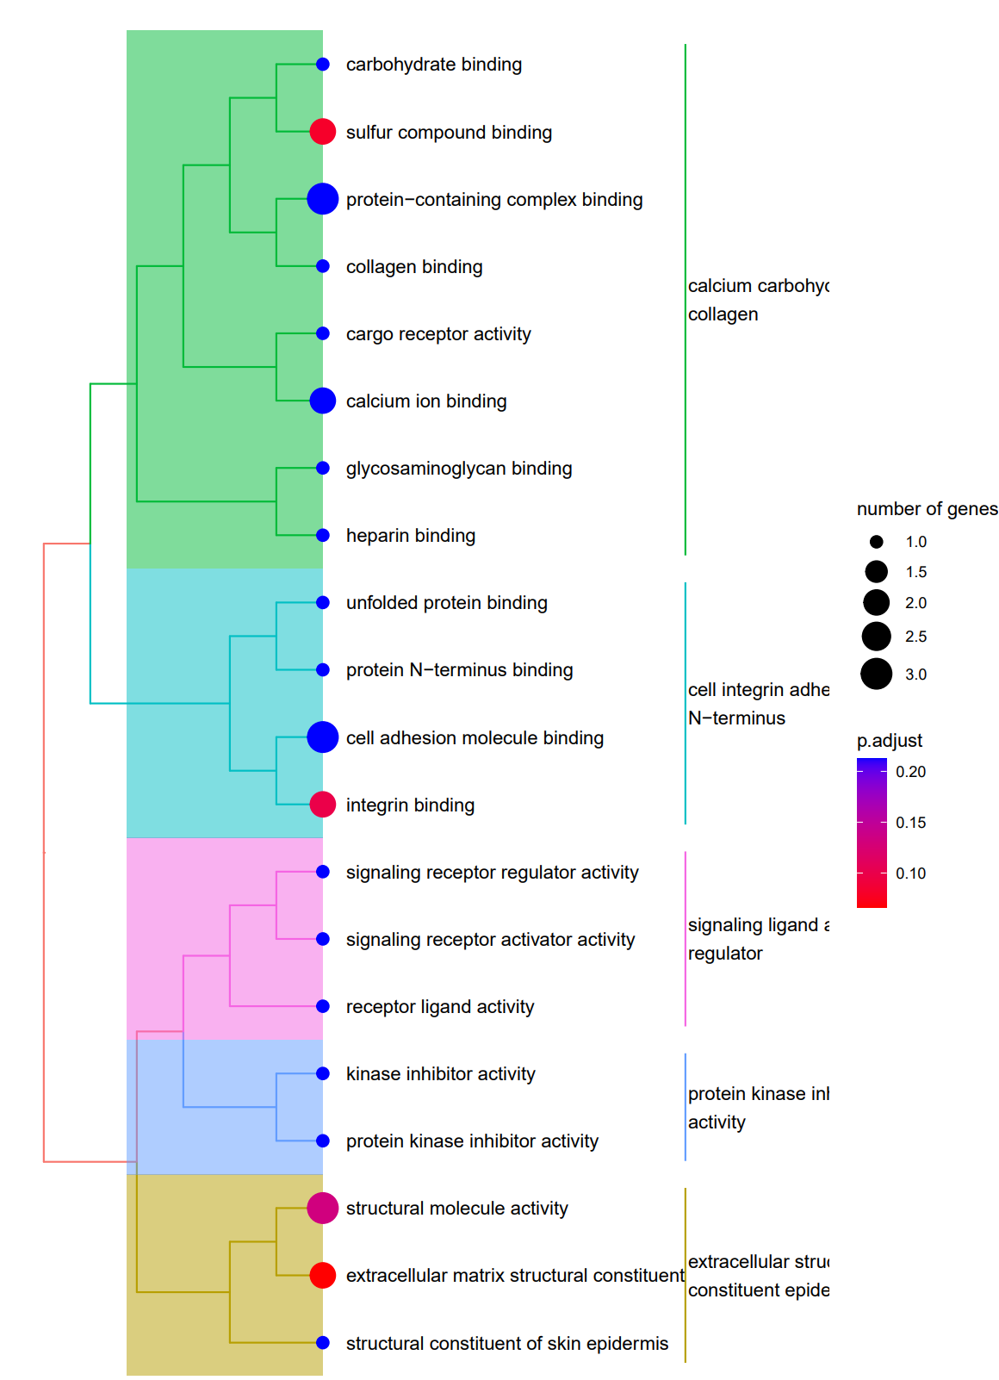
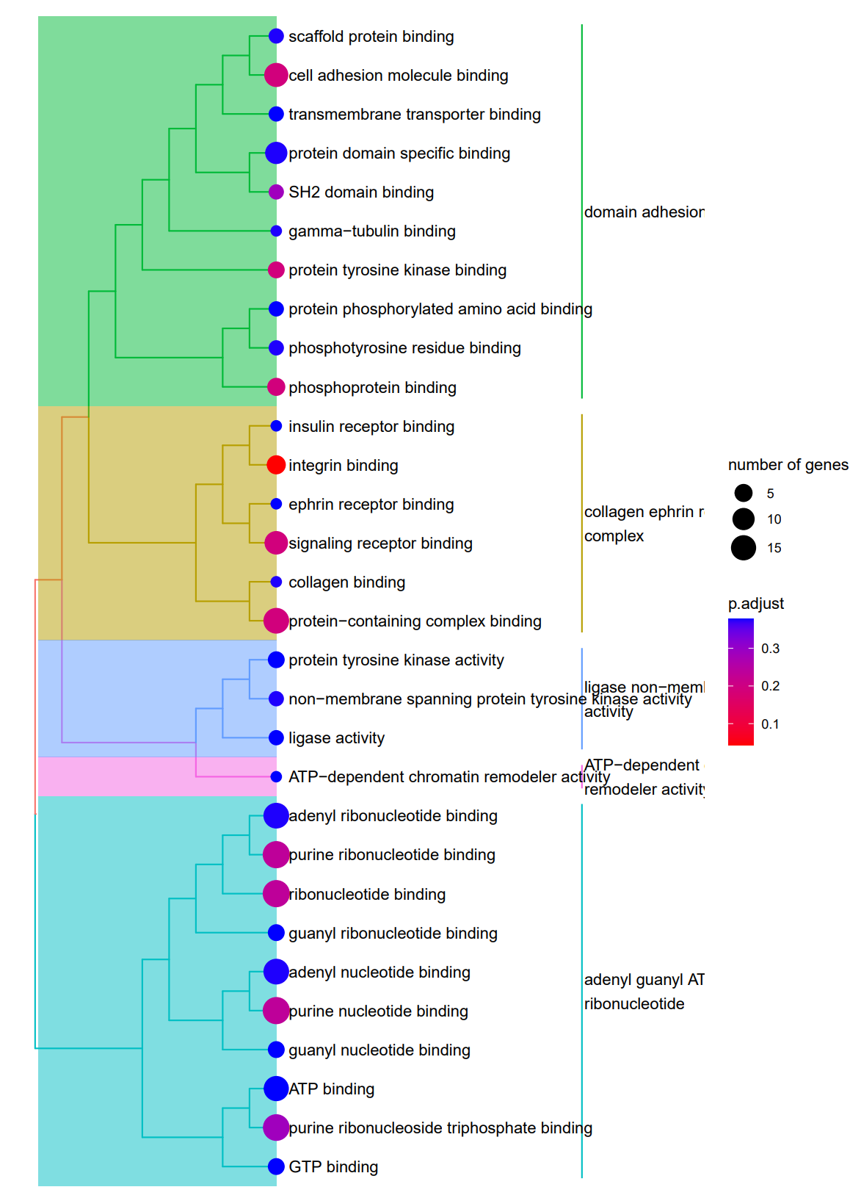
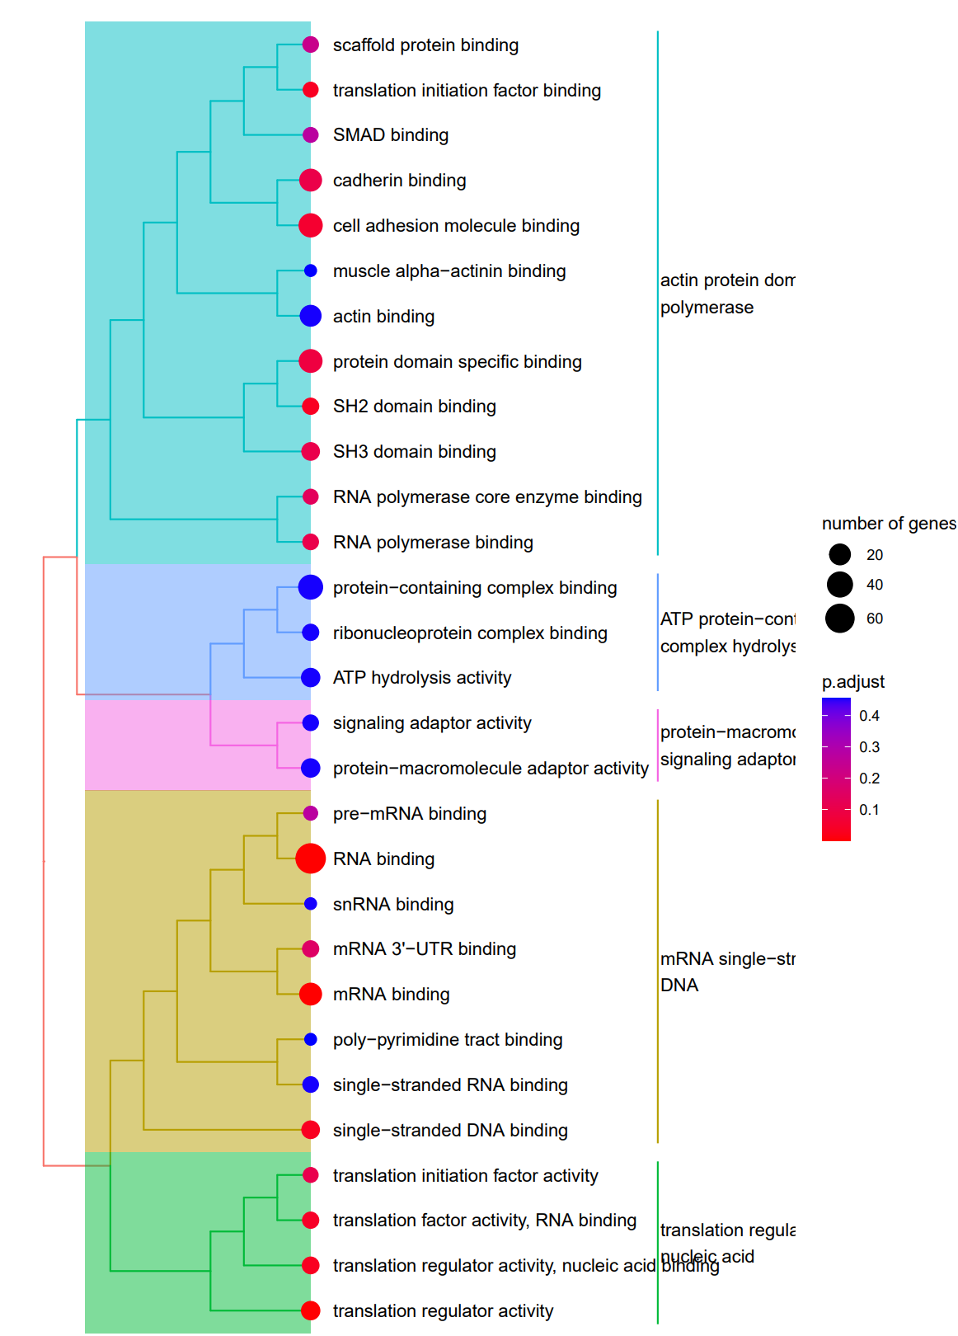
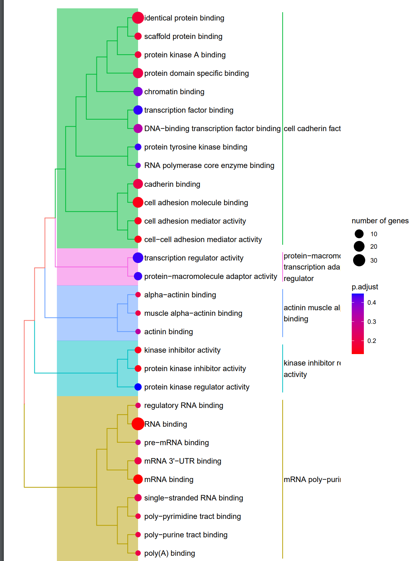
Enrichment analysis: Molecular Function GO terms
NB: Small number of genes, hits not significant post-FDR, but seem biologically relevant
m/z -0.0175_-0.0125
m/z -0.0125_-0.0075
m/z 0.0075_0.0125
m/z 0.0125_0.0175
Binding
+
sulfur
ECM
Generally, binding, not very dissimilar from DECOY

Slide 19
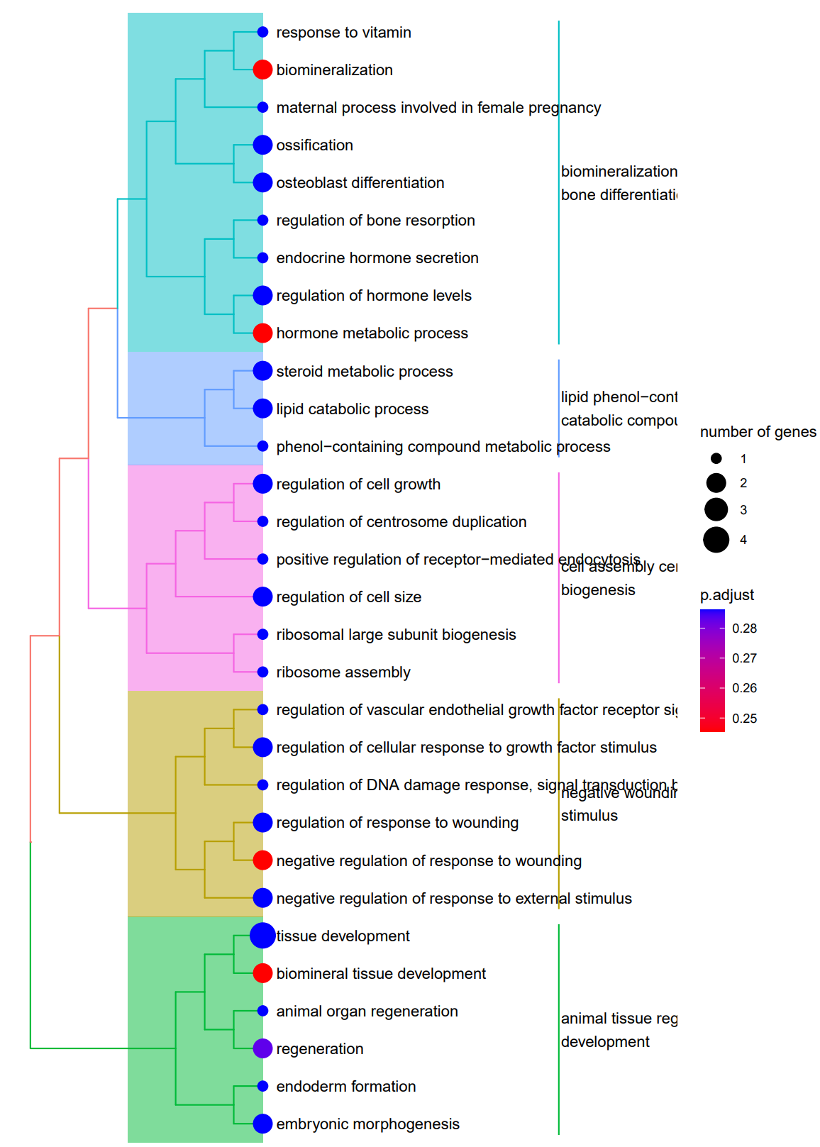
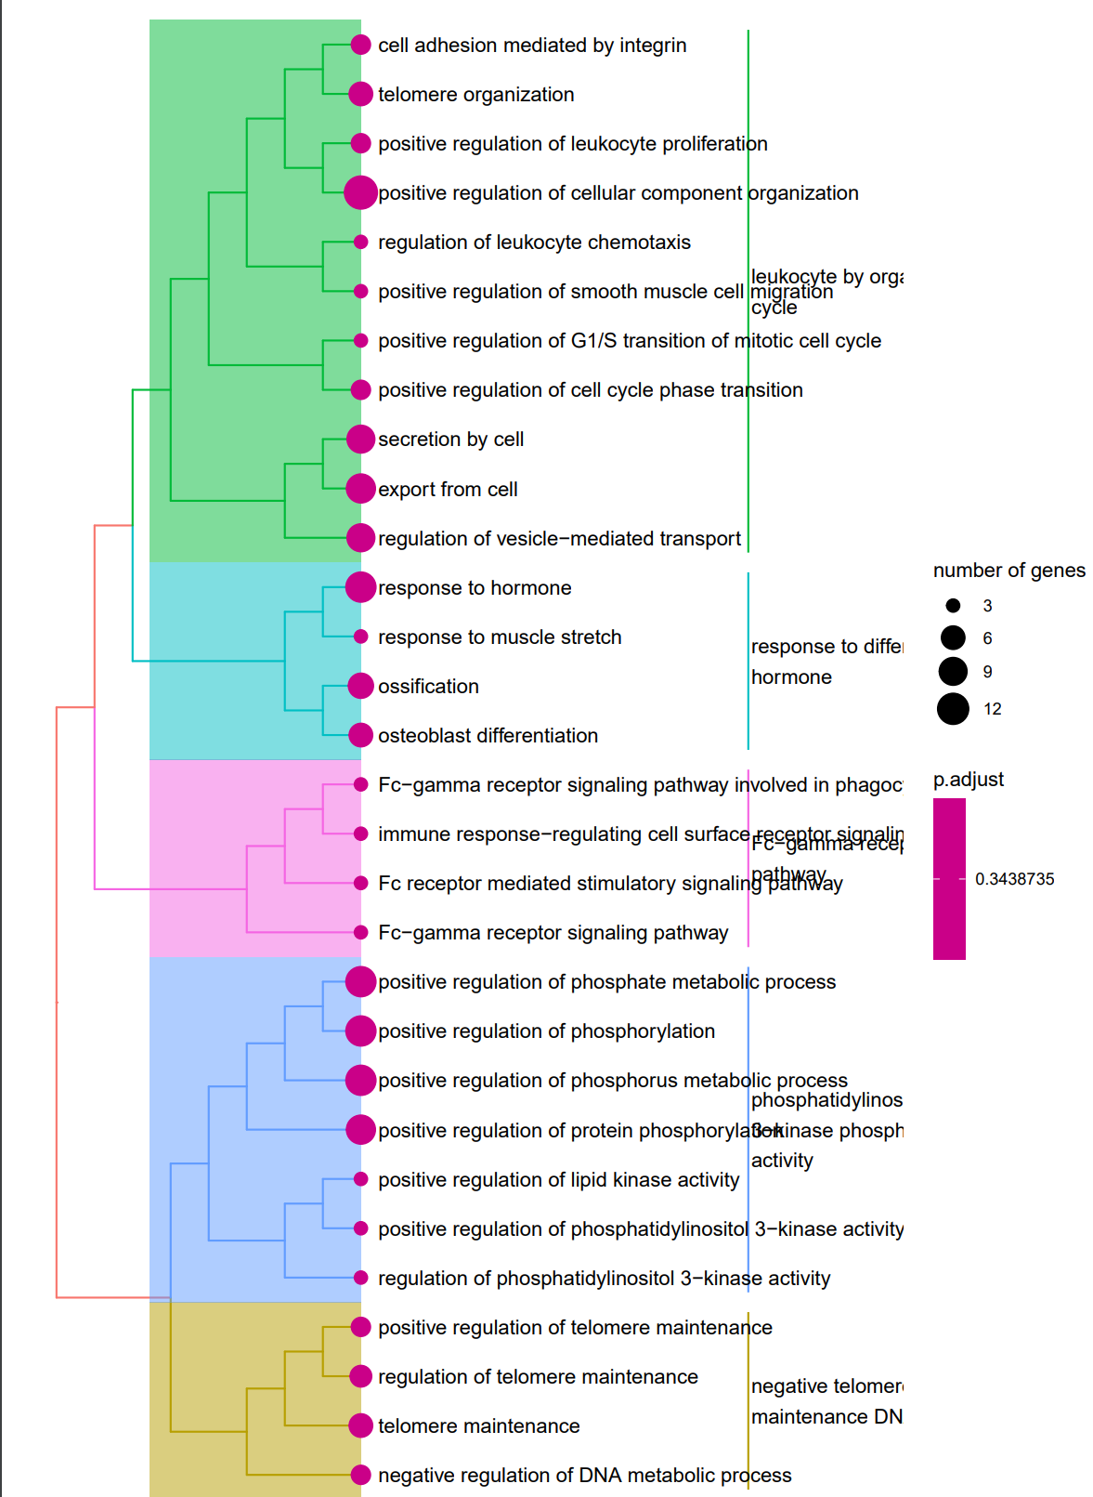
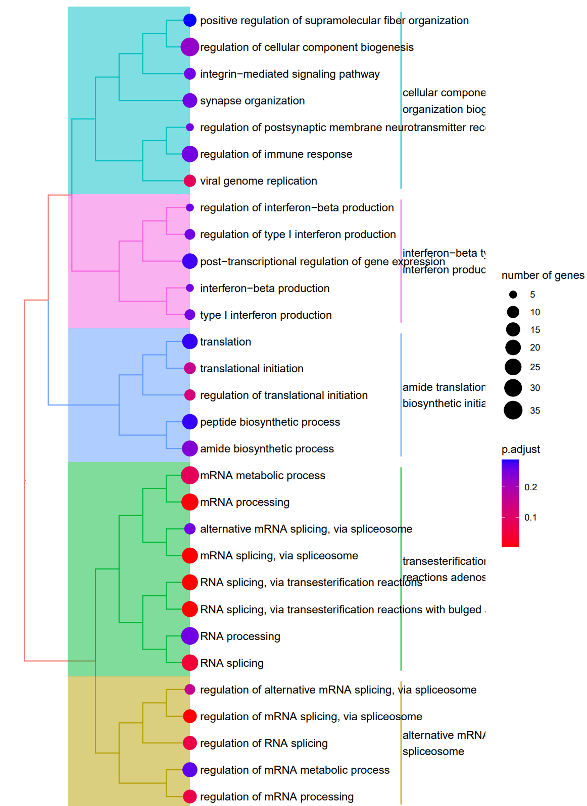
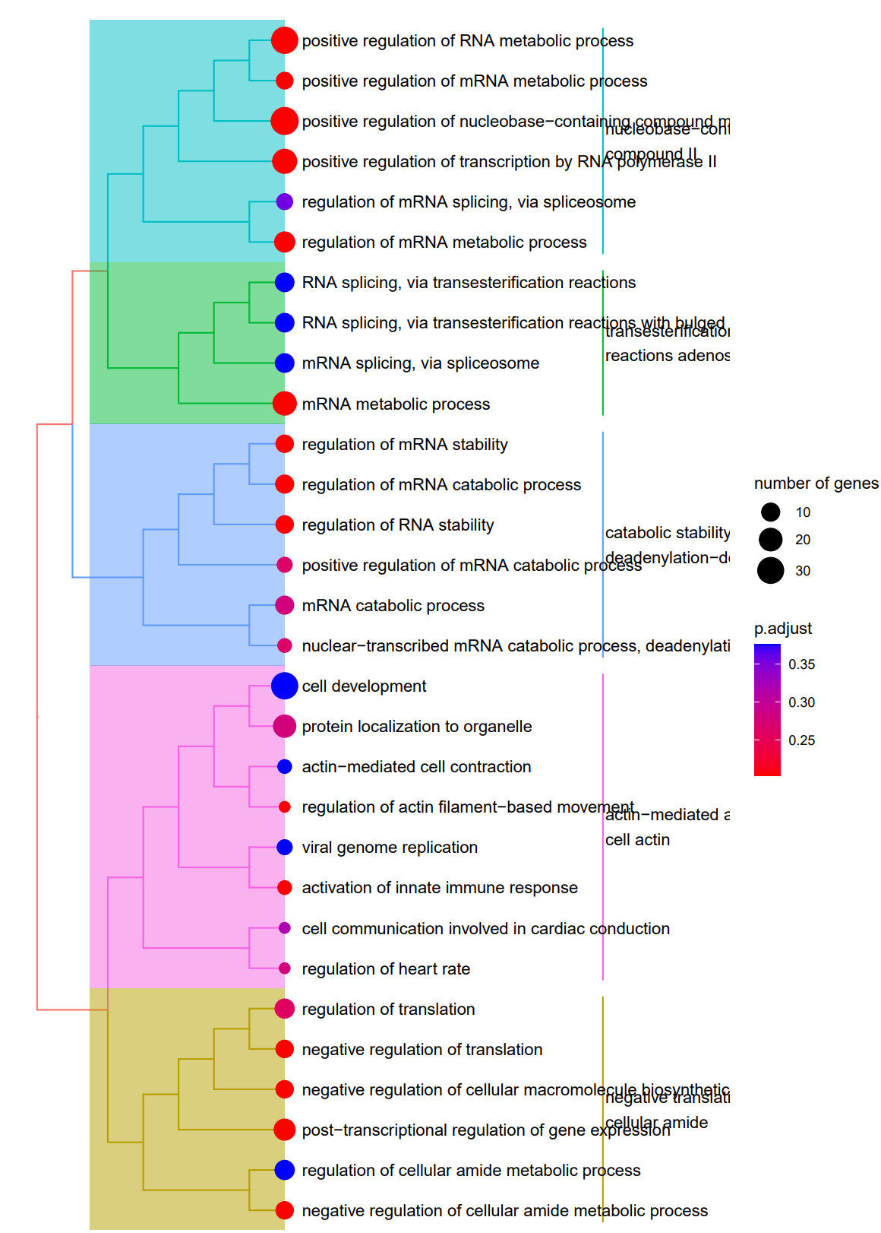
Enrichment analysis: Biological process GO terms
NB: Small number of genes, hits not significant post-FDR, but seem biologically relevant
m/z -0.0175_-0.0125
m/z -0.0125_-0.0075
m/z 0.0075_0.0125
m/z 0.0125_0.0175
Biomineralisation
Secretion
Ossification
mRNA regulation

Slide 20
Enrichment analysis isn’t very convincing (e.g. adj. p values high, small number of proteins), although biologically some terms make sense
Look at peptidoforms individually – specific protein IDs, what is the evidence they are or may be sulfated – lots of them are membrane-bound or secreted, especially the ones with convincing histograms (e.g. can manually filter false positives).
Plot histograms for each dataset they were detected in – is one dataset with many PSMs skewing the results, is the -0.01 peak present in multiple? – plots generated for 90+ peptidoforms.

Slide 21
Ideas that came up from meeting with Anthony and Eva
Create our own set of background proteins known to have sulfotyrosines based on SwissProt and see if our bin of interest is enriched in peptidoforms stemming from such proteins compared to the DECOY bins. (rather than fishing for GO terms like I have till now)
Wouldn’t it be better to only look at the data from more sensitive instruments (reduce noise and make GMM models more sensitive; including less sensitive data could be biasing the results towards not being able to enrich for sulfo – vs if we look at sensitive the conclusion could be sensitive can detect sulfo, less sensitive can not)?
Can we split instruments into sensitive vs not sensitive and see if we’re seeing an enrichment in data from sensitive instruments in e.g. bin of interest peptidoform IDs or peptidoform IDs so far manually assigned as likely sulfated?
Can we colour histograms based on dataset ID (or instrument sensitivity rather than manually looking at hundreds of histograms, one for each dataset – stacked bar chart effect)
GMM model filtering – could probably use some tuning – e.g. rather than 15% of the sum of AUCs for all GMM components, 15% or a larger percentage in just one AUC? This could increase true positives but should retain false positives to a similar level? Do we want to optimise for potential true positives or minimise false positives and show stronger evidence for sulfotyrosine detection?

